Slide 1
Project Name
Members name

Slide 2
Problem Description
Automated Essay Grading with feedback

Slide 3
Methodologies and technologies used
Write technologies
Write data set and tell about it
Write the models we are using

Slide 4
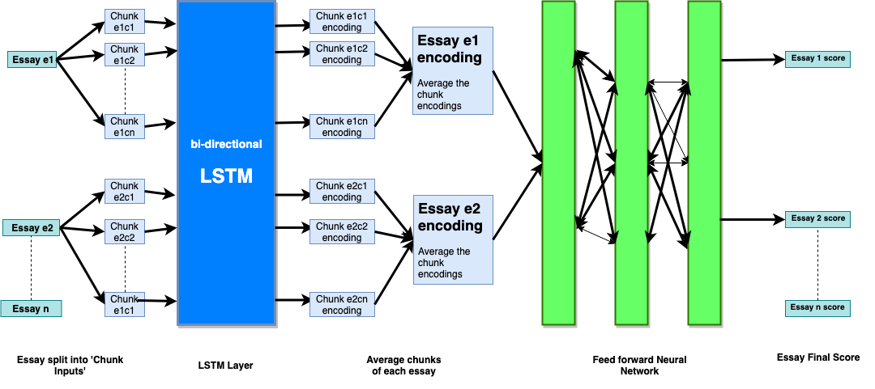
Our model

Slide 5
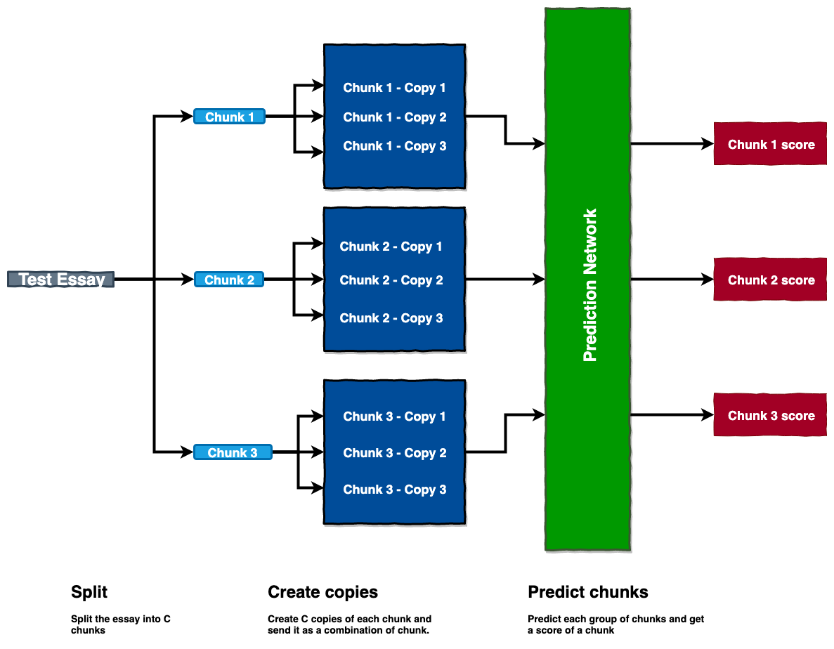
Chunk Prediction

Slide 6
Results
Word embedding | LSTM | GRU | RNN
Glove vectors | 0.1639 | 0.17119 | 0.1839
Word2vec | 0.1692 | 0.17851 | 0.1851

Slide 7
Related Work
https://web.stanford.edu/class/archive/cs/cs224n/cs224n.1174/reports/2731315.pdf
http://web.stanford.edu/class/cs224n/reports/custom/15722887.pdf
Hello
Hello

